Slide 1

(GEO)Coding to Solve a Crime Mystery
Data analysis using Python, Pandas, Geopandas and other amazing stuff.

Slide 2


Slide 3
Outline
I CSI special training (Getting familiar with spatial stuff)
CRS. Coordinate Reference System
Projections
Points
Polygons
II Collecting the evidence (Mastering Spatial joins)
Collecting suspects footprints (manipulating spatial stuff as a pro)
Identifying suspects paths ( Mastering Spatial joins)
Collecting the victim’s evidence (Loading Multiple Geo datasets)
III Solving the case (Mapping spatial stuff)
Mapping victim’s and suspicious footprints (getting familiar with data visualizations for spatial stuff)
Solving the case

Slide 4
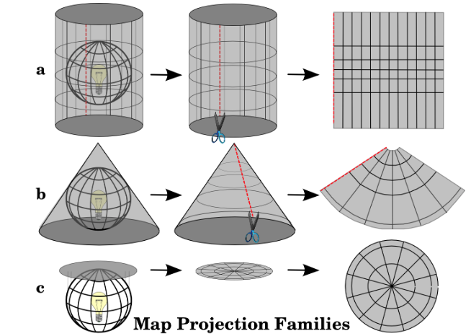
CRS
A coordinate reference system (CRS) defines, with the help of coordinates, how the two-dimensional projected map is related to real places on the earth.
The three families of map projections. They can be represented by a) cylindrical projections, b) conical projections or c) planar projections.

Slide 5
With the help of coordinate reference systems (CRS) every place on the earth can be specified by a set of three numbers, called coordinates.
CRS:
projected coordinate reference systems
geographic coordinate reference systems

Slide 6
CRS | geographic coordinate reference systems:
The use of Geographic Coordinate Reference Systems is very common.
They use degrees of latitude and longitude and sometimes also a height value to describe a location on the earth’s surface.
The most popular is called WGS 84.

Slide 7
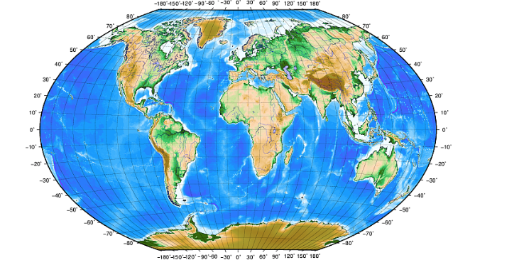
longitud
latitud

Slide 8
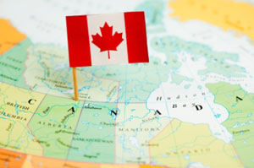

Slide 9
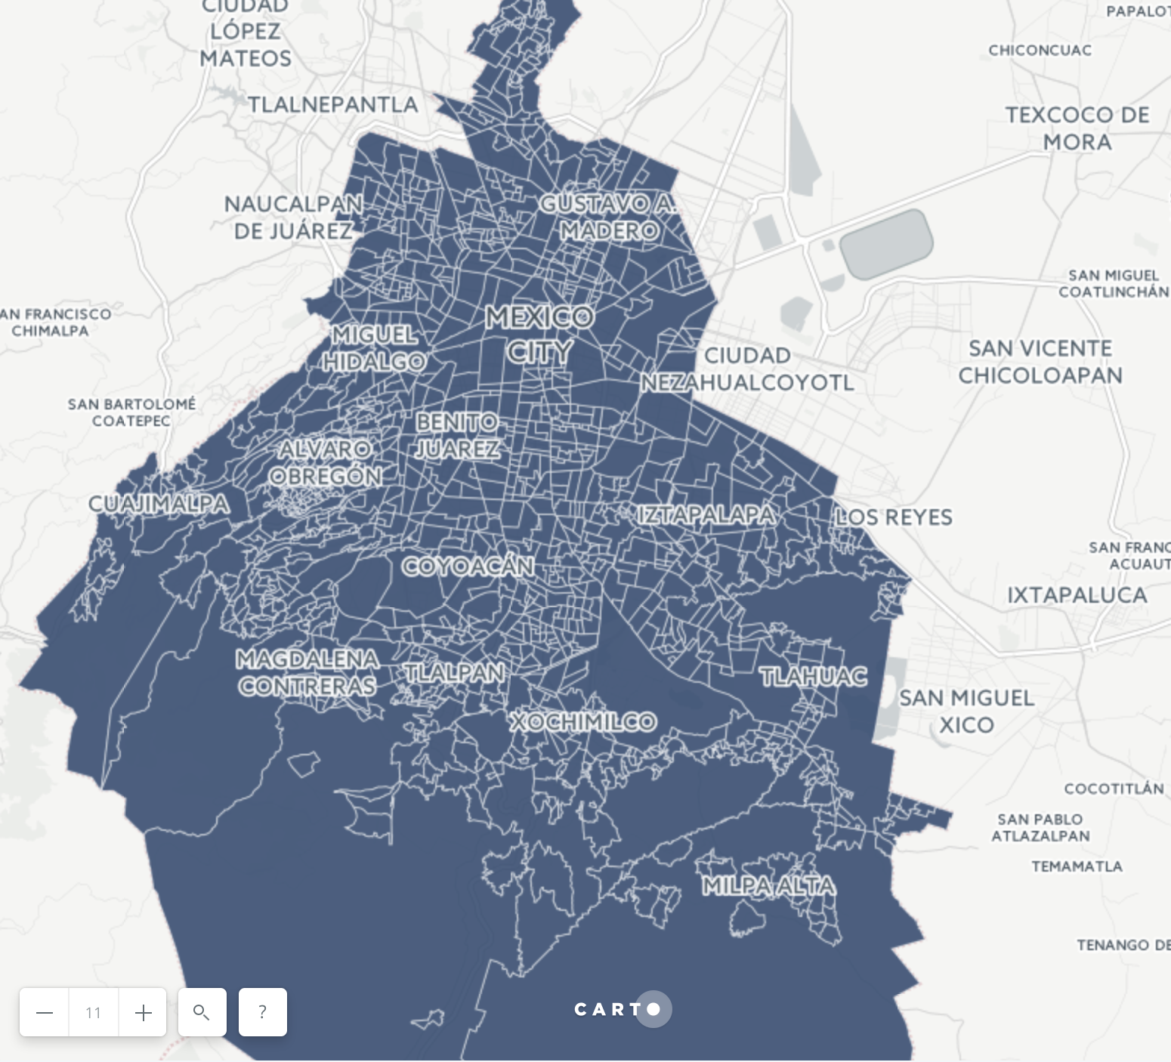

Slide 10
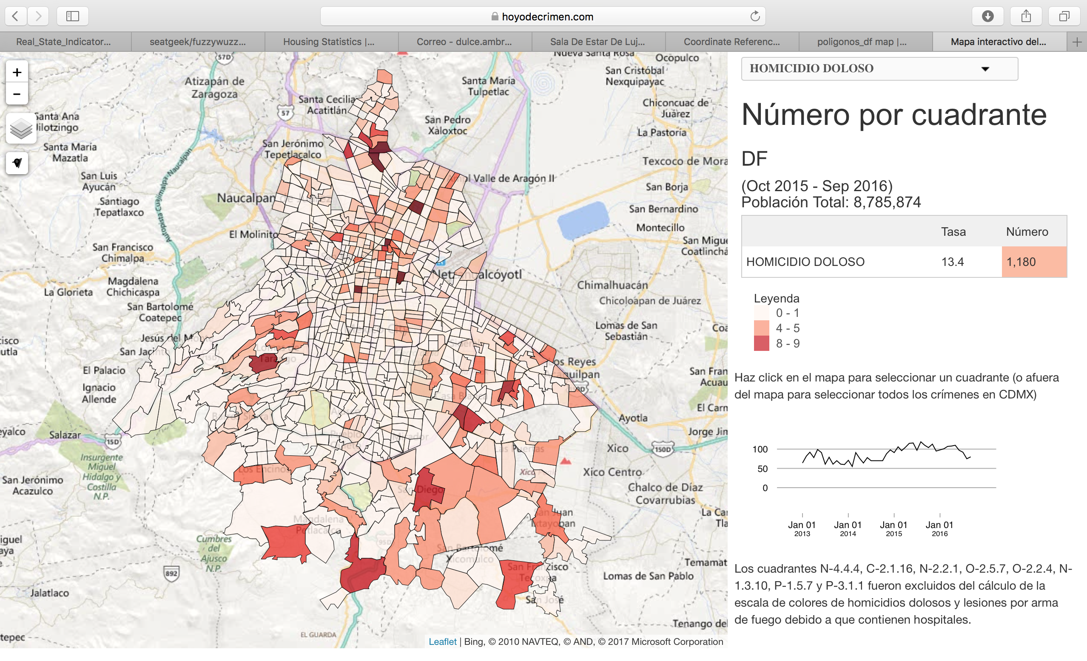
Hoyo del crimen:https://hoyodecrimen.com/cuadrantes-mapa#11/19.3675/-99.1475

Slide 12

The evidence
Beth
Lorraine
James
John
Martha

Slide 13
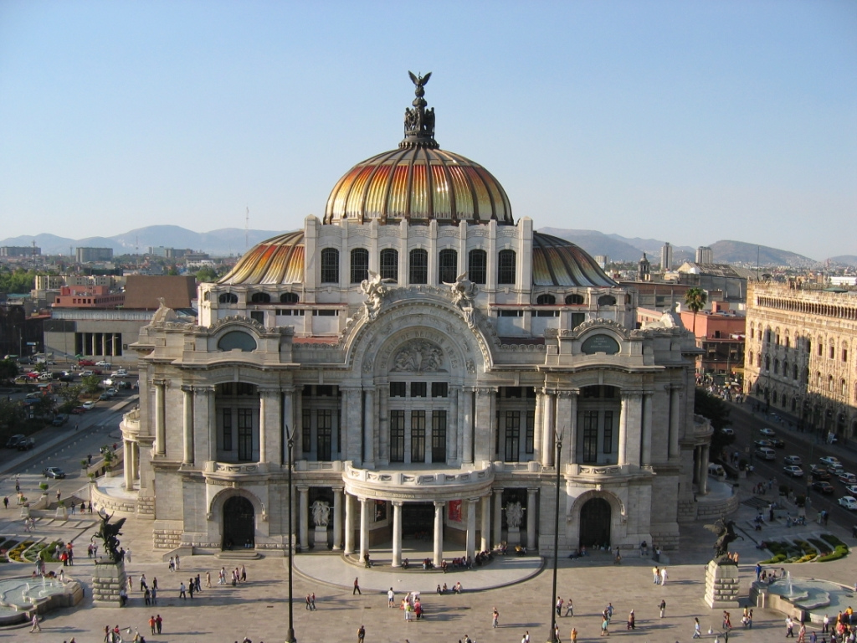


Slide 15

Pandas

Slide 16


¡Gracias!
Dulce Ambrocio
Data Scientist @TrueHome
dulce@truehome.com.mx
dulce.ambrocio@hotmail.com

Slide 17
Going further
CRS for nerds: http://docs.qgis.org/2.0/es/docs/gentle_gis_introduction/coordinate_reference_systems.html
Geopandas: http://geopandas.org

